Slide 1
AUTONOMOUS DRONE NAVIGATION USING CNN
Created by:
K . CHOCKALINGAM
912321104004
SACS M.A.V.M.M ENGINEERING COLLEGE MADURAI

Slide 2
Project Agenda:
Problem statement
Proposed system/solution
System Development Approach
Algorithm and Deployment
Result
Conclusion
Reference

Slide 3
Problem Statement:
The problem statement of autonomy drone navigation typically involves developing algorithms and systems that enable drones to navigate their environment without human Intervention This includes tasks such as obstacle avoidance, path planning, localization, and tracking , all while ensuring safety and efficiency in various scenarios and environments.

Slide 4
Proposed system/solution:
1.HARDWARE COMPONENTS:
GPS Module: Provides the drone with its absolute position on the Earth's surface.
IMU (Inertial Measurement Unit): Measures the drone's acceleration, velocity, and orientation.
Barometer: Measures altitude by detecting changes in air pressure.
Onboard Camera(s): Used for visual navigation, obstacle avoidance, and capturing images for mapping
2.Softcomponents:
Flight Controller Software: Controls the drone's motors based on input from various sensors to stabilize and navigate the drone.
Navigation Algorithm: Determines the optimal path from the drone's current position to its destination while avoiding obstacles.
Obstacle Detection and Avoidance Software: Analyzes data from onboard sensors to detect obstacles and adjust the flight path accordingly.
Mapping and Localization Software: Builds and updates a map of the environment using data from onboard sensors and external sources (e.g., GPS) and localizes the drone within this map.

Slide 5
Proposed system and solution ( continue):
3.Navigation Algorithms:
Waypoint Navigation: Direct the drone to predefined GPS coordinates.
Path Planning: Generate a collision-free path from the drone's current position to its destination, considering obstacles and environmental constraints.
SLAM (Simultaneous Localization and Mapping): Allows the drone to build a map of its environment in real-time while simultaneously localizing itself within that map.
Reactive Navigation: Immediate response to dynamic obstacles encountered during flight.
4.Testing and Validation:
Conduct extensive testing in simulated and real-world environments to validate the system's performance and safety.
Continuously iterate and improve the system based on feedback and real-world usage.

Slide 6
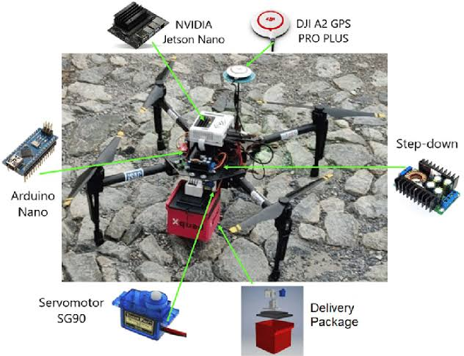
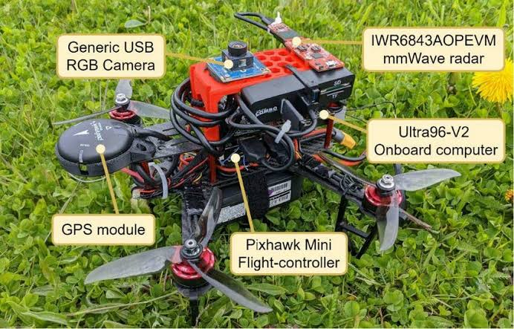
Proposed system and solution(Continue):
5.Safety Features:
Groening : Define virtual boundaries to restrict the drone's movement within a predefined area.
Emergency Landing Procedures: Activate in case of critical system failures or loss of communication.
Redundant Systems: Backup systems for critical components to ensure continued operation in case of failure.

Slide 7
System development Approach:
1.Requirements Gathering: Understand the purpose of drone navigation. Are you navigating in outdoor or indoor environments? What are the required functionalities, such as waypoint navigation, obstacle avoidance, or GPS-based navigation
2.Hardware Selection: Choose appropriate hardware components such as flight controllers, GPS modules, sensors (e.g., accelerometers, gyroscopes, proximity sensors), and communication modules.

Slide 8
System development approach (continue):
3. Testing and Validation: Test the in various scenarios to ensure its reliability and performance. Validate against predefined metrics such as accuracy, speed, and robustness.
4.Iterative Improvement: Gather feedback from testing and real-world usage to identify areas for improvement. Iterate on the design and implementation to enhance navigation capabilities and address any issues.
5.Regulatory Compliance: Ensure compliance with regulations governing drone operations, especially concerning safety and privacy.
6.Deployment and Maintenance: Deploy the system on drones and regularly maintain it to address any issues or updates.

Slide 9
Algorithm and Deployment:
Designing an algorithm for drone navigation involves several key steps, including path planning, obstacle avoidance, localization, and control. Once the algorithm is developed, it needs to be deployed onto the drone's onboard computer for real-time execution. Here's a general overview of the process:
1.Path Planning:
Define the mission objectives and constraints, such as target destinations, no-fly zones, and battery limitations.
Choose an appropriate path planning algorithm, such as A*, RRT (Rapidly-exploring Random Trees), or potential fields.
Generate a collision-free path from the drone's current position to the target destination.

Slide 10
Algorithm and deployment (continue):
2.Obstacle Avoidance:
Use sensors (such as , ultrasonic, or cameras) to detect and avoid obstacles in real-time. This can involve techniques like reactive control or model predictive control.
3.Localization:
Estimate the drone’s position and orientation relative to its environment. This is often done using GPS , IMU (Inertial Measurement Unit) , and visual technique
4.Control:
Generate commands to adjust the drone’s motion based on the planned path, obstacle avoidance, and localization information. PID controllers are commonly used for stability and control.

Slide 11
Algorithm and deployment (continue):
5.Algorithm Integration:
Combine path planning, obstacle avoidance, localization, and control algorithms into a cohesive system.
Ensure efficient communication and data exchange between different components of the navigation system.
6.Simulation and Testing:
Use simulation environments to test the navigation algorithms in various scenarios before deployment.
Conduct extensive real-world testing to validate the performance of the algorithm under different conditions.
7.Deployment:
Transfer the finalized navigation algorithm onto the drone's onboard computer Optimize the code for real-time execution and resource constraints of the onboard hardware.
Ensure robustness and reliability of the deployed system through thorough testing and validation.

Slide 12
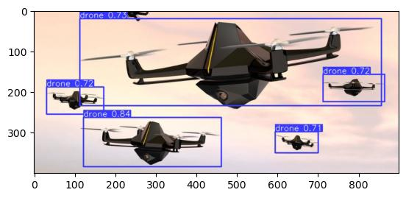
Result:
Fig: Detection and validation of drone navigation

Slide 13
Conclusion:
In conclusion, drone navigation involves the integration of various algorithms for path planning, obstacle avoidance, localization, and control. These algorithms enable drones to autonomously navigate through environments while avoiding obstacles and reaching their destinations safely and efficiently. Deployment of drone navigation systems requires robust integration, consideration of power consumption, communication reliability, and adherence to safety protocols. Additionally, thorough testing and validation are essential to ensure the system’s effectiveness in real-world scenarios. As technology continues to advance, drone navigation capabilities are expected to improve, enabling a wide range of applications across industries such as delivery, surveillance, and infrastructure inspection.

Slide 14
Reference:
https://www.emqopter.de/en/deliverydrone.php
https://ieeexplore.ieee.org/document/9836219
https://auterion.com/delivery-anywhere-with-autonomous-drones/
https://www.aboutamazon.com/news/transportation/how-amazon-is-building-its-drone-delivery-system

Slide 15
THANK YOU

